Slide 1
Chapter 8
ROTATION

Slide 2
This lecture will help you understand:
Circular Motion
Rotational Inertia
Torque
Center of Mass and Center of Gravity
Centripetal Force
Centrifugal Force
Angular Momentum
Conservation of Angular Momentum

Slide 3
Circular Motion
When an object turns about an internal axis, it is undergoing circular motion or rotation.
Circular Motion is characterized by two kinds of speeds:
  tangential (or linear) speed.
  rotational (or circular) speed.

Slide 4
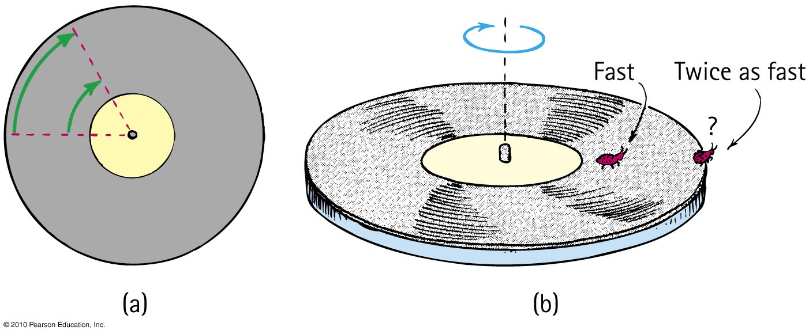
Circular Motion—Tangential Speed
The distance traveled by a point on the rotating object divided by the time taken to travel that distance is called its tangential speed (symbol v).
Points closer to the circumference have a higher tangential speed that points closer to the center.

Slide 5
Circular Motion – Rotational Speed
Rotational (angular) speed is the number of rotations or revolutions per unit of time (symbol ω).
All parts of a rigid merry-go-round or turntable turn about the axis of rotation in the same amount of time.
So, all parts have the same rotational speed.
Tangential speed
= Radial Distance × Rotational Speed
ν = rω

Slide 6
A ladybug sits halfway between the rotational axis and the outer edge of the turntable . When the turntable has a rotational speed of 20 RPM and the bug has a tangential speed of 2 cm/s, what will be the rotational and tangential speeds of her friend who sits at the outer edge?
1 cm/s
2 cm/s
4 cm/s
8 cm/s

Slide 7

A ladybug sits halfway between the rotational axis and the outer edge of the turntable . When the turntable has a rotational speed of 20 RPM and the bug has a tangential speed of 2 cm/s, what will be the rotational and tangential speeds of her friend who sits at the outer edge?
1 cm/s
2 cm/s
4 cm/s
8 cm/s
Explanation:
Tangential speed
=
Rotational speed of both bugs is the same, so if radial distance doubles, tangential speed also doubles.
So, tangential speed is 2 cm/s × 2 = 4 cm/s.

Slide 8
Rotational Inertia
An object rotating about an axis tends to remain rotating about the same axis at the same rotational speed unless interfered with by some external influence.
The property of an object to resist changes in its rotational state of motion is called rotational inertia (symbol I).

Slide 9
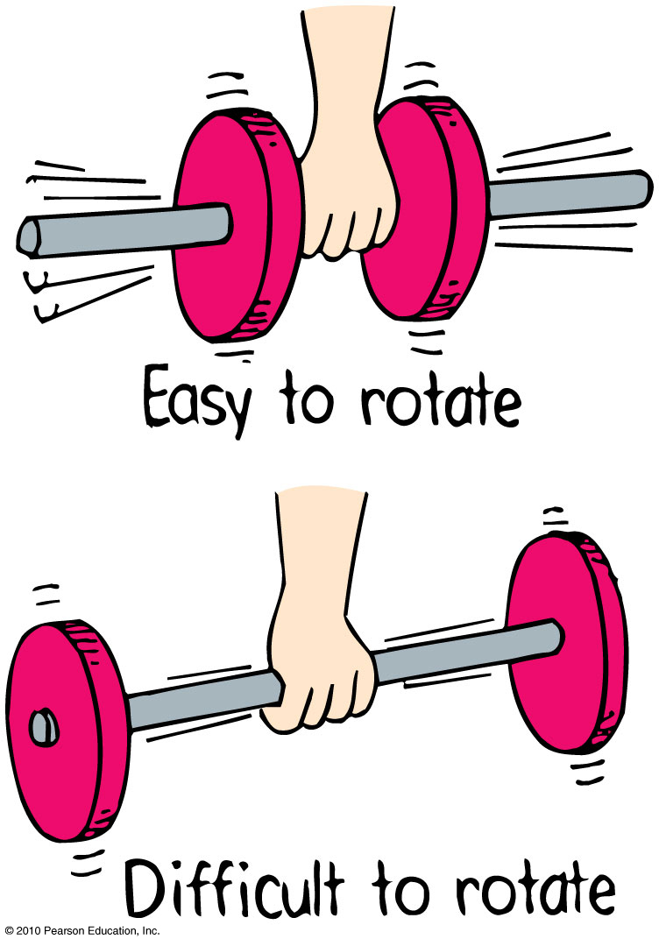
Rotational Inertia
Depends upon
mass of object.
distribution of mass around axis of rotation.
  The greater the distance between an object’s mass concentration and the axis, the greater the rotational inertia.

Slide 10
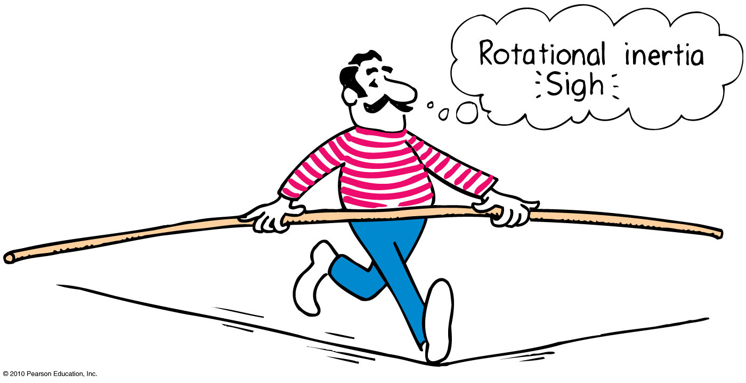
Rotational Inertia
The greater the rotational inertia, the harder it is to change its rotational state.
  A tightrope walker carries a long pole that has a high rotational inertia, so it does not easily rotate.
  Keeps the tightrope walker stable.

Slide 11
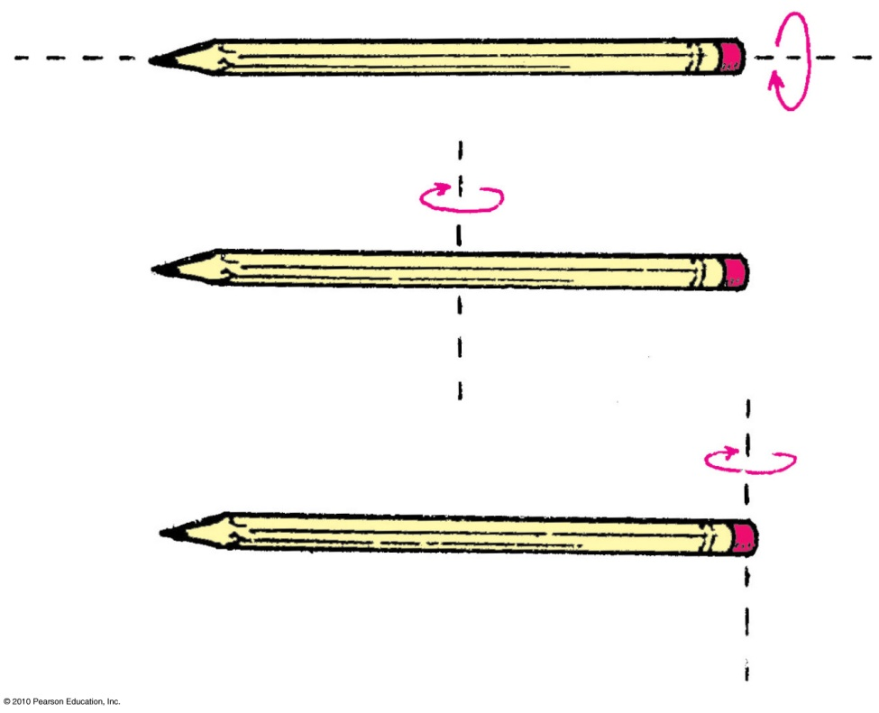
Rotational Inertia
Depends upon the axis around which it rotates
Easier to rotate pencil around an axis passing through it.
Harder to rotate it around vertical axis passing through center.
Hardest to rotate it around vertical axis passing through the end.

Slide 12
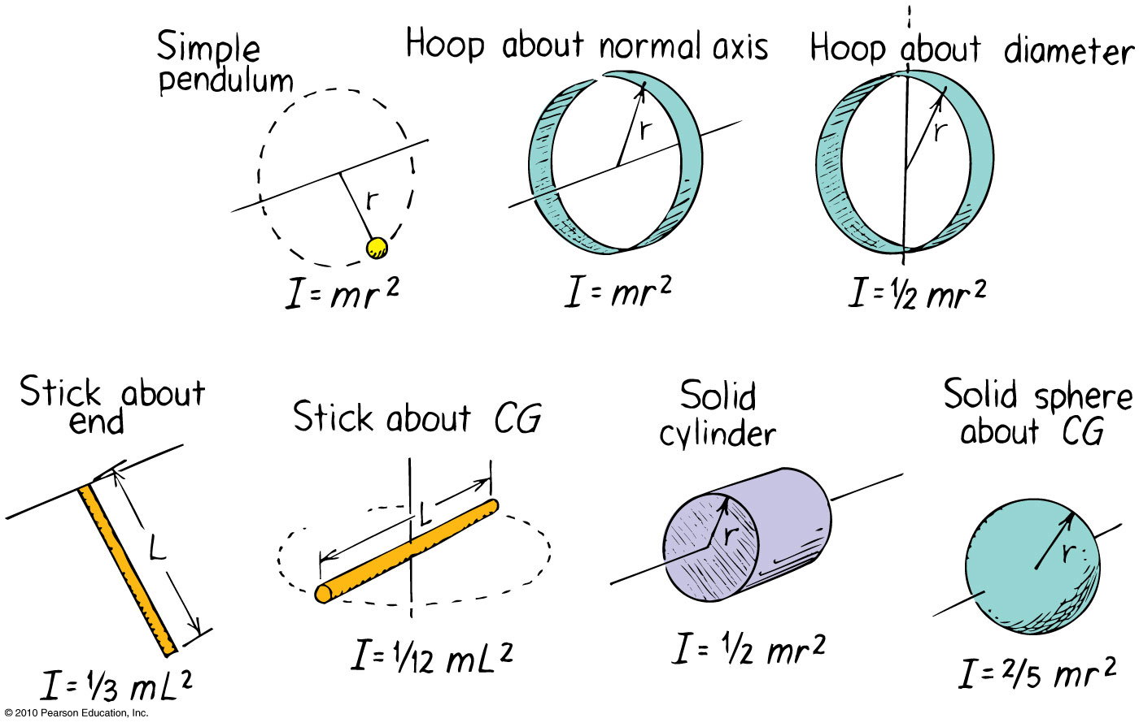
Rotational Inertia
The rotational inertia depends upon the shape of the object and its rotational axis.

Slide 13
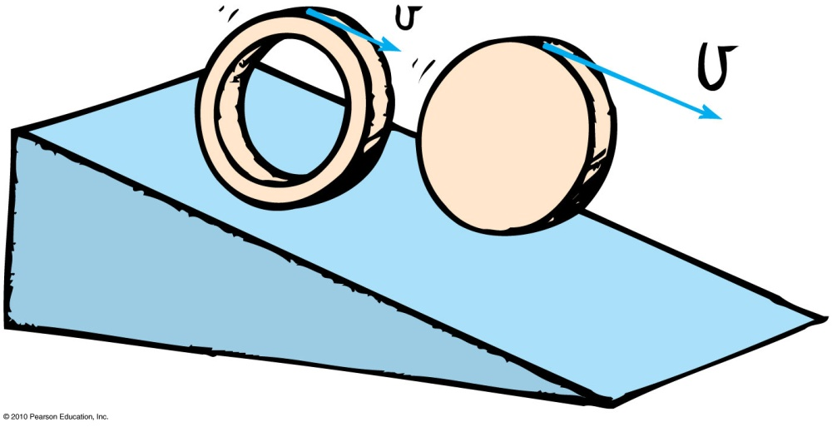
A hoop and a disk are released from the top of an incline at the same time. Which one will reach the bottom first?
Hoop
Disk
Both together
Not enough information

Slide 14
A hoop and a disk are released from the top of an incline at the same time. Which one will reach the bottom first?
Hoop
Disk
Both together
Not enough information
Explanation:
Hoop has larger rotational inertia, so it will be slower in gaining speed.
The mass of the hoop is more toward the circumference, compared to the disk in which it is uniformly spread out.
So, the rotational inertia of the hoop is larger than the disk
So, the hoop will be harder to rotate, and will reach the bottom later.

Slide 15
Torque
The tendency of a force to cause rotation is called torque.
Torque depends upon three factors:
  Magnitude of the force
  The direction in which it acts
  The point at which it is applied on the object

Slide 16
Torque
The equation for Torque is
The lever arm depends upon
  where the force is applied.
  the direction in which it acts.
Torque = lever arm × force

Slide 17
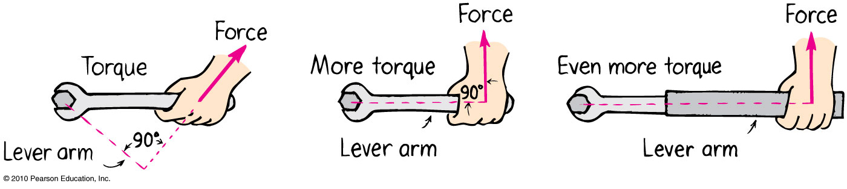
Torque—Example
1st picture: Lever arm is less than length of handle because of direction of force.
2nd picture: Lever arm is equal to length of handle.
3rd picture: Lever arm is longer than length of handle.

Slide 18
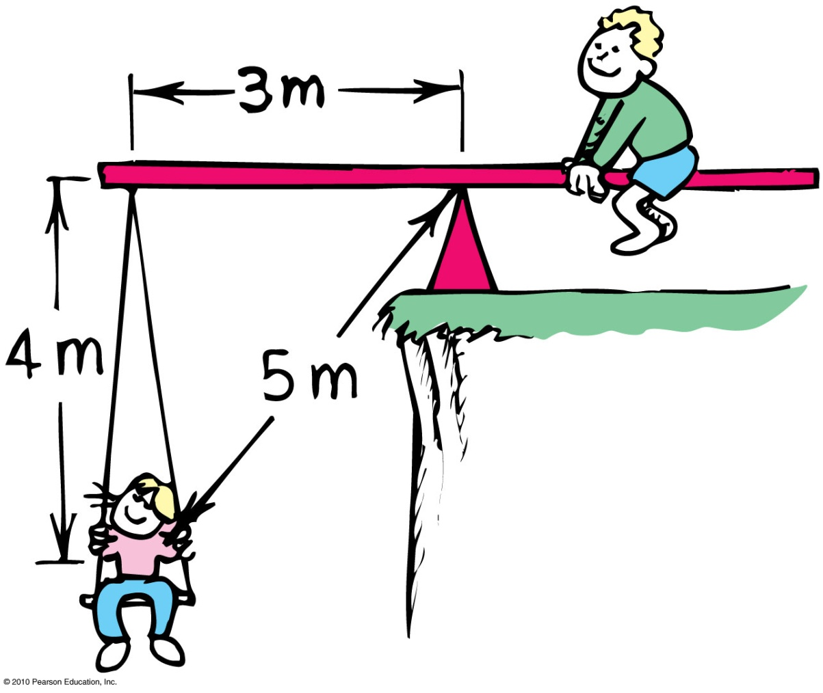
Girl’s weight = 250N, boy’s weight = 500N. The boy is 1.5 m from the fulcrum.
Suppose the girl on the left suddenly is handed a bag of apples weighing 50 N. Where should she sit order to balance, assuming the boy does not move?
1 m from pivot
1.5 m from pivot
2 m from pivot
2.5 m from pivot

Slide 19

Girl’s weight = 250N, boy’s weight = 500N. The boy is 1.5 m from the fulcrum.
Suppose the girl on the left suddenly is handed a bag of apples weighing 50 N. Where should she sit in order to balance, assuming the boy does not move?
1 m from pivot
1.5 m from pivot
2 m from pivot
2.5 m from pivot
Explanation:
She should exert same torque as before.
Torque = lever arm × force
= 3 m × 250 N = 1.5m x 500N
= 750 Nm
Torque = new lever arm × force
750 Nm = new lever arm × 300N
⇒ New lever arm = 750 Nm / 300 N = 2.5 m

Slide 20
Center of Mass and Center of Gravity
Center of mass is the average position of all the mass that makes up the object.
Center of gravity (CG) is the average position of weight distribution.
  Since weight and mass are proportional, center of gravity and center of mass usually refer to the same point of an object.

Slide 21
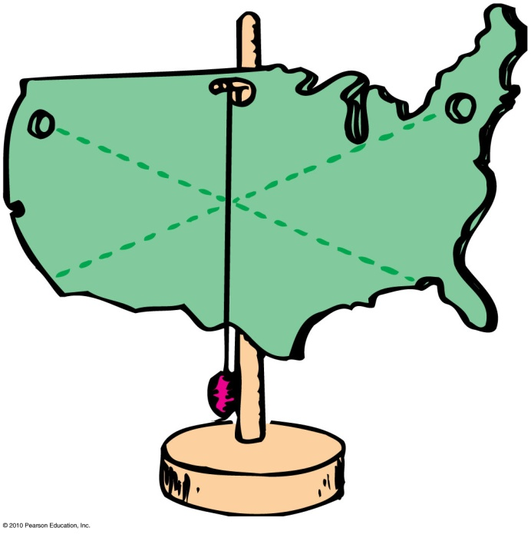
Center of Mass and Center of Gravity
To determine the center of gravity,
  suspend the object from a point and draw a vertical line from suspension point.
  repeat after suspending from another point.
The center of gravity lies where the two lines intersect.

Slide 22
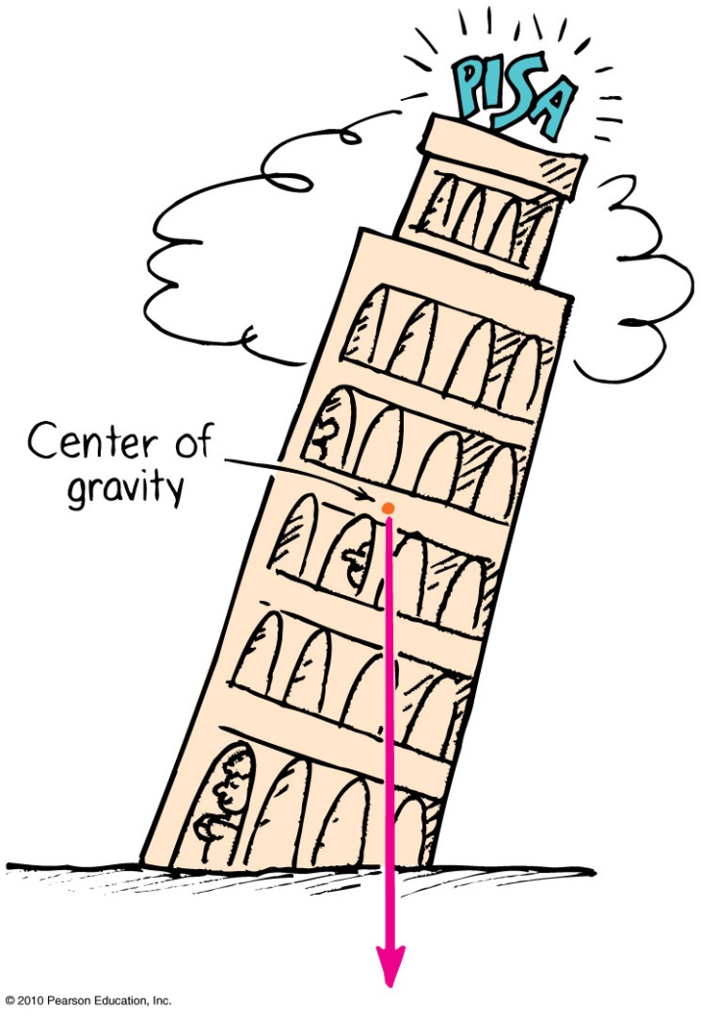
Center of Gravity—Stability
The location of the center of gravity is important for stability.
If we draw a line straight down from the center of gravity and it falls inside the base of the object, it is in stable equilibrium; it will balance.
If it falls outside the base, it is unstable.

Slide 23
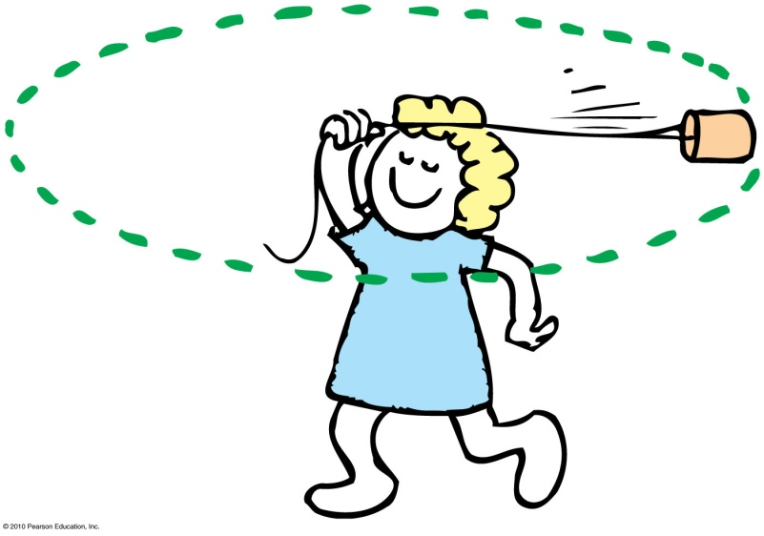
Centripetal Force
Any force directed toward a fixed center is called a centripetal force.
Centripetal means “center-seeking” or “toward the center.”
Example: To whirl a tin can at the end of a string, you pull the string toward the center and exert a centripetal force to keep the can moving in a circle.

Slide 24
Centripetal Force
Depends upon
  mass of object.
  tangential speed of the object.
  radius of the circle.
In equation form:
m
a
s
s
×
t
a
n
g
e
n
t
i
a
l
s
p
e
e
d
2
C
e
n
t
r
i
p
e
t
a
l
f
o
r
c
e
=
r
a
d
i
u
s

Slide 25
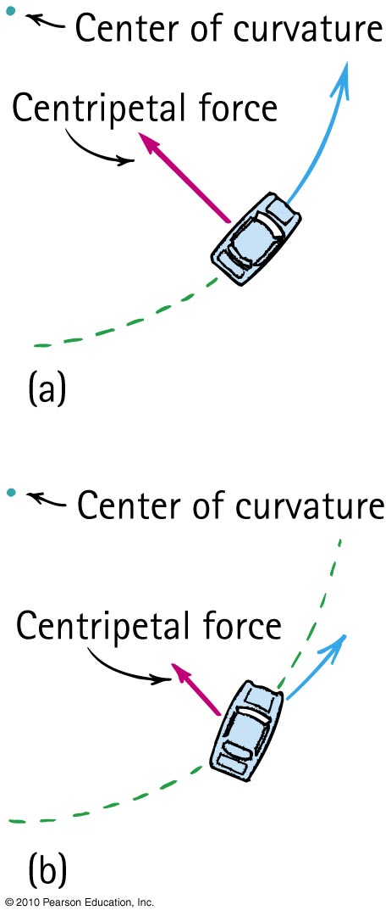
Centripetal Force—Example
When a car rounds a curve, the centripetal force prevents it from skidding off the road.
If the road is wet, or if the car is going too fast, the centripetal force is insufficient to prevent skidding off the road.

Slide 26
Suppose you double the speed at which you round a bend in the curve, by what factor must the centripetal force change to prevent you from skidding?
Double
Four times
Half
One-quarter

Slide 27
Suppose you double the speed at which you round a bend in the curve, by what factor must the centripetal force change to prevent you from skidding?
Double
Four times
Half
One-quarter
Explanation:
Because the term for “tangential speed” is squared, if you double the tangential speed, the centripetal force will be double squared, which is four times.
mass ×
tangential
speed
2
Centripeta
l
force
=
radius

Slide 28
Suppose you take a sharper turn than before and halve the radius, by what factor will the centripetal force need to change to prevent skidding?
Double
Four times
Half
One-quarter

Slide 29
Suppose you take a sharper turn than before and halve the radius; by what factor will the centripetal force need to change to prevent skidding?
Double
Four times
Half
One-quarter
Explanation:
Because the term for “radius” is in the denominator, if you halve the radius, the centripetal force will double.
mass ×
tangential
speed
2
Centripeta
l
force
=
radius

Slide 30
Centrifugal Force
Although centripetal force is center directed, an occupant inside a rotating system seems to experience an outward force. This apparent outward force is called centrifugal force.
Centrifugal means “center-fleeing” or “away from the center.”

Slide 31
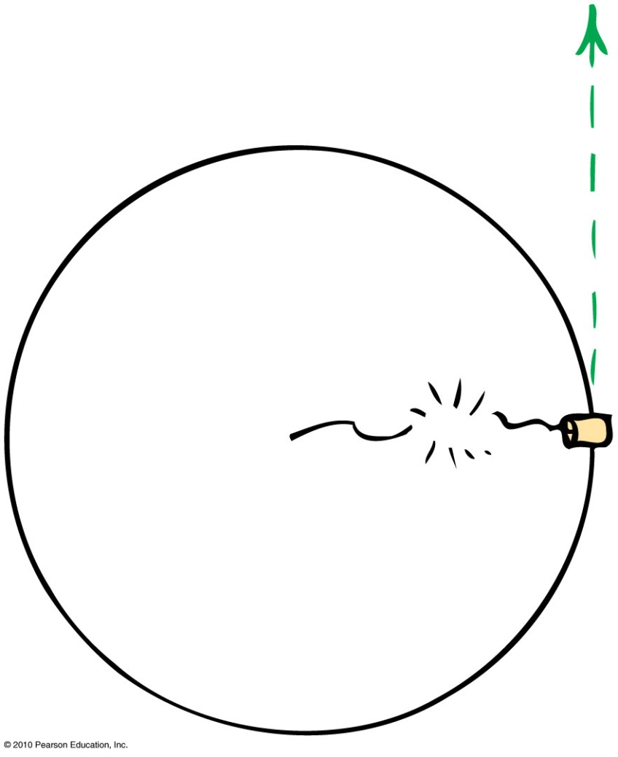
Centrifugal Force
– A Common Misconception
It is a common misconception that a centrifugal force pulls outward on an object.
Example:
  If the string breaks, the object doesn’t move radially outward.
  It continues along its tangent straight-line path—because no force acts on it. (Newton’s first law)

Slide 32
Angular Momentum
The “inertia of rotation” of rotating objects is called angular momentum.
  This is analogous to “inertia of motion”, which was momentum.
Angular momentum
= rotational inertia × angular velocity
  This is analogous to
  Linear momentum = mass × velocity

Slide 33
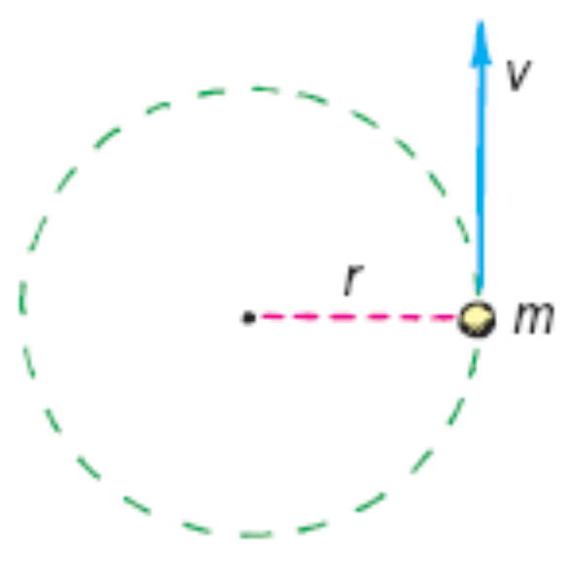
Angular Momentum
For an object that is small compared with the radial distance to its axis, magnitude of
Angular momentum = mass tangential speed × radius
  This is analogous to magnitude of
  Linear momentum = mass × speed
Examples:
  Whirling ball at the end of a long string
  Planet going around the Sun

Slide 34
Angular Momentum
An external net torque is required to change the angular momentum of an object.
Rotational version of Newton’s first law:
  An object or system of objects will maintain its angular momentum unless acted upon by an external net torque.

Slide 35
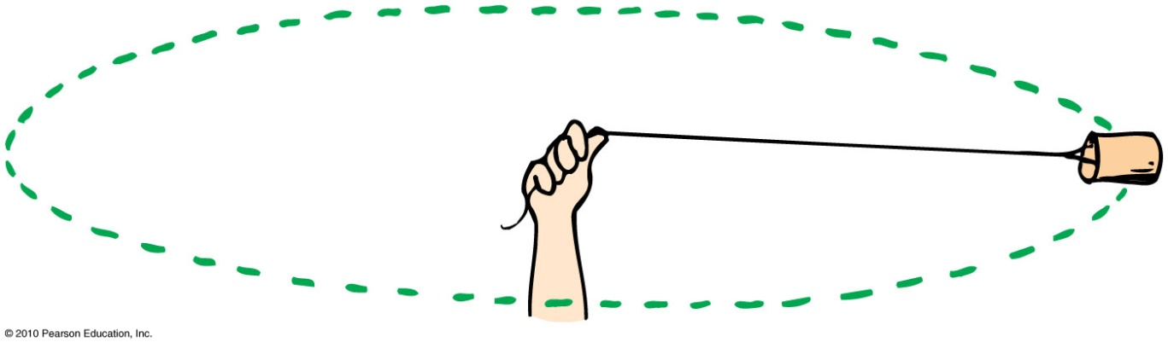
Suppose you are swirling a can around and suddenly decide to pull the rope in halfway; by what factor would the speed of the can change?
Double
Four times
Half
One-quarter

Slide 36
Suppose you are swirling a can around and suddenly decide to pull the rope in halfway, by what factor would the speed of the can change?
Double
Four times
Half
One-quarter
Explanation:
Angular Momentum is proportional to radius of the turn.
No external torque acts with inward pull, so angular momentum is conserved. Half radius means speed doubles.
Angular momentum
= mass tangential speed × radius

Slide 37
Conservation of Angular Momentum
The law of conservation of angular momentum states:
  If no external net torque acts on a rotating system, the angular momentum of that system remains constant.
Analogous to the law of conservation of linear momentum:
  If no external force acts on a system, the total linear momentum of that system remains constant.

Slide 38
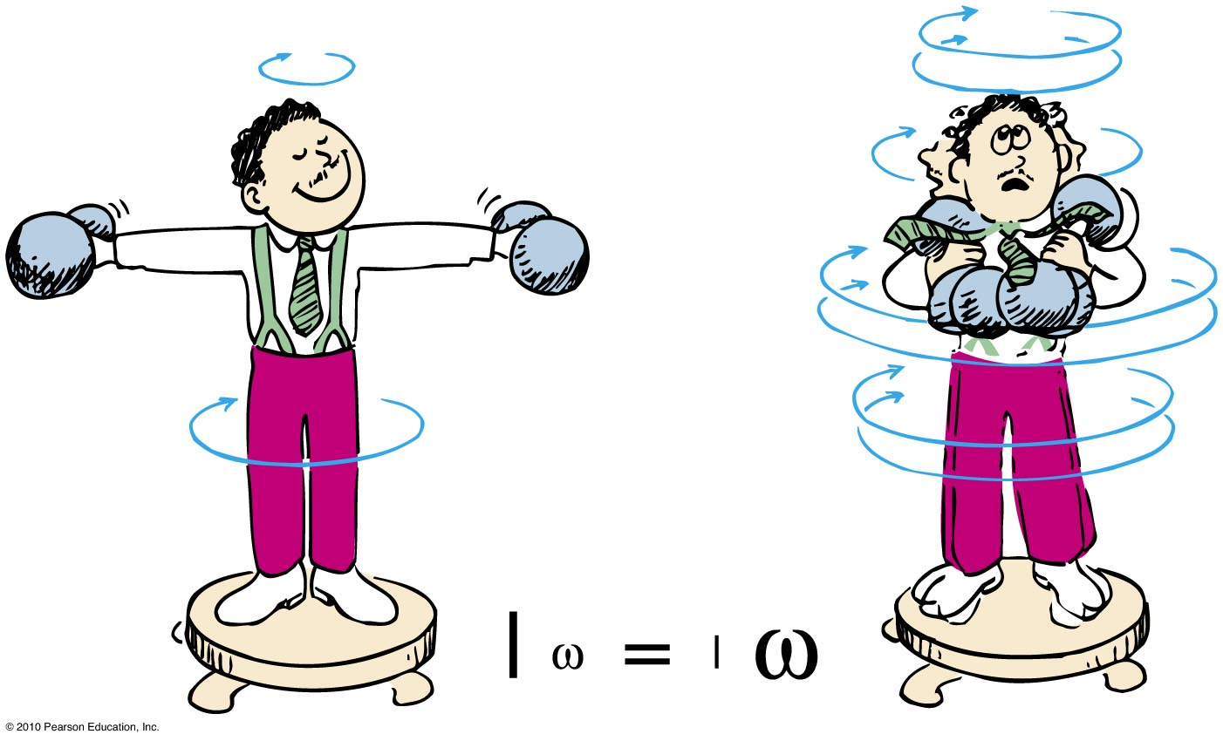
Conservation of Angular Momentum
Example:
When the man pulls the weights inward, his rotational speed increases!

Slide 39
Suppose by pulling the weights inward, the rotational inertia of the man reduces to half its value. By what factor would his angular velocity change?
Double
Three times
Half
One-quarter
Notes:
A. double

Slide 40
Suppose by pulling the weights in, if the rotational inertia of the man decreases to half of his initial rotational inertia, by what factor would his angular velocity change?
Double
Three times
Half
One-quarter
Explanation:
Angular momentum is proportional to “rotational inertia”.
If you halve the rotational inertia, to keep the angular momentum constant, the angular velocity would double.
Angular momentum
= rotational inertia × angular velocity

Slide 41
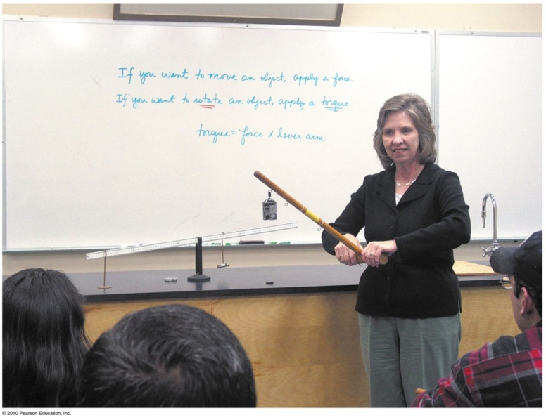
Chapter 8 Problems
4. Mary Beth uses a torque feeler that consists of a meter-stick held at the 0-cm end with a weight dangling from various positions along the stick (see Figure 8.17). When the stick is held horizontally, what torque is produced when a 1-kg mass hangs from the 50cm mark?
How much more torque is exerted when it is hung from the 75-cm mark?
τ = 10Nx0.75m = 7.5 Nm
τ he 100-cm mark?
τ = 10Nx1m = 10 Nm

Slide 42
Chapter 8 Problems
4. Mary Beth uses a torque feeler that consists of a meter-stick held at the 0-cm end with a weight dangling from various positions along the stick (see Figure 8.17). When the stick is held horizontally, what torque is produced when a 1-kg mass hangs from the 50cm mark?
τ = F d = mgd
τ = 1kgx10m/s²x0.5m
τ = 5 Nm
How much more torque is exerted when it is hung from the 75-cm mark?

Slide 43
Chapter 8 Problems
4. Mary Beth uses a torque feeler that consists of a meter-stick held at the 0-cm end with a weight dangling from various positions along the stick (see Figure 8.17). When the stick is held horizontally, what torque is produced when a 1-kg mass hangs from the 50cm mark?
τ = F d = mgd
τ = 1kgx10m/s²x0.5m
τ = 5 Nm
How much more torque is exerted when it is hung from the 75-cm mark?
τ = 10Nx0.75m = 7.5 Nm
τ he 100-cm mark?
τ = 10Nx1m = 10 Nm

Slide 44
Chapter 8 Problems
If a trapeze artist rotates once each second while sailing through the air and contracts to reduce her rotational inertia to one-third of what it was, how many rotations
per second will result?

Slide 45
Chapter 8 Problems
If a trapeze artist rotates once each second while sailing through the air and contracts to reduce her rotational inertia to one-third of what it was, how many rotations
per second will result?
Since no external forces are applied then conservation of angular momentum states that:
(Rotational Inertia, I) x (angular velocity, ω) must not change
I_{before} ω_{before} = I_{after} x ω_{after} or I_{before} ω_{before} = (1/3)I_{before}
So ω_{after} = I_{before} ω_{before} / (1/3)I_{before}
ω_{after} = 3 ω_{before} = 3x1 rps = 3 rps

Slide 46
Homework
Read Chapter 8 in Detail.
Do Ranking 3, 4
Do Exercises 1, 33, 36, 39
Do problems 2, 3.
(You must show your calculations !!! )
Homework due: June 18

